Slide 1
HPC War stories: Processing multi-terabyte sequence datasets
Micha Bayer
Information and Computational Sciences Dept

Slide 2
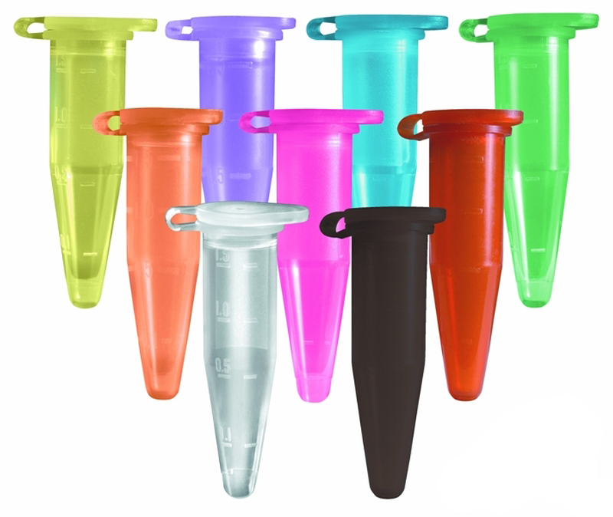
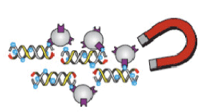
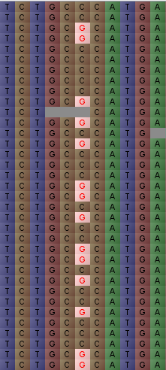
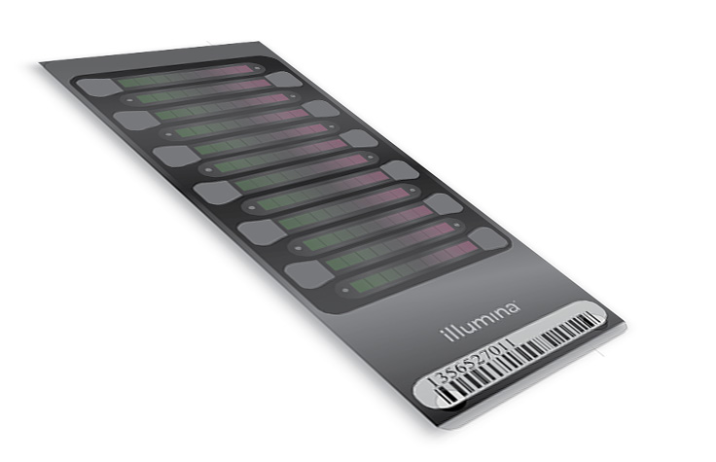
The project
475 Barley cultivar samples --BBSRC UK Barley Genome project
Exome capture and sequencing
Read mapping and variant calling
genotyping chip design

Slide 3
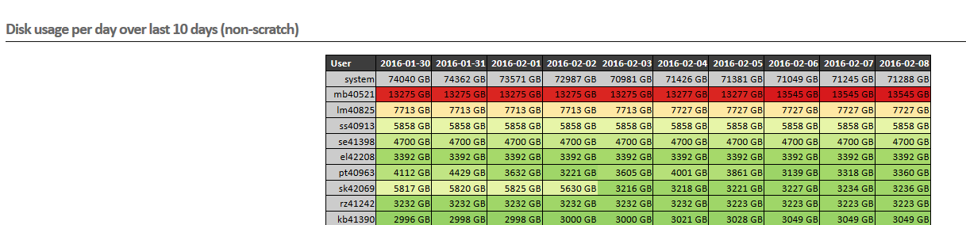
The Data
Number of samples sequenced | 475
Total data volume of exome capture data | 1.95 TB (compressed) (~ 8TB uncompressed)
BAM files | 2.0 TB (compressed)
GVCF files | 659 GB (compressed)
total number of reads | ~ 19 billion
total number of bases | ~ 2.4 trillion
mean number of reads per sample | ~ 40 million
mean coverage of 61Mbp exome capture space per sample | ~ 84 x

Slide 4
Where does the time go?
sample 1 BAM file
sample 2 BAM file
sample N BAM file
Map reads with BWA
Using a single processor: 475 samples * 2 CPU days = 950 days (2.6 years)
Deduplication, indel realignment, base quality recalibration
recalibrated BAM file 1
recalibrated BAM file 2
recalibrated BAM file N
~2 CPU days/
sample
GATK HaplotypeCaller
GVCF file 1
GVCF file 2
GVCF file N
GATK CombineGVCFs
combined GVCF file
31 h
GATK GenotypeVCFS
14 h
raw VCF file
custom filtering
final VCF file
2 h
post-processing
cross-validation with iSelect data
visualization of variants with Tablet
visualization of variant patterns with Flapjack
extract statistics (heterozygosity etc.)

Slide 5

Lessons learnt
Processing data in batches as it arrives is messy and a data management nightmare
Don’t run all of your jobs simultaneously unless you want to be chased down the corridor by an angry mob
Manual checking/QC of results on this scale doesn’t work – need tools to automate at least part of this
Patience, patience, patience…
The final array job was too much to take for the Hutton staff

